Slide 1
Avalanche Next Host Controller
Setup and Test walk-through
Robert Collazo
Feb 20, 2015

Slide 2
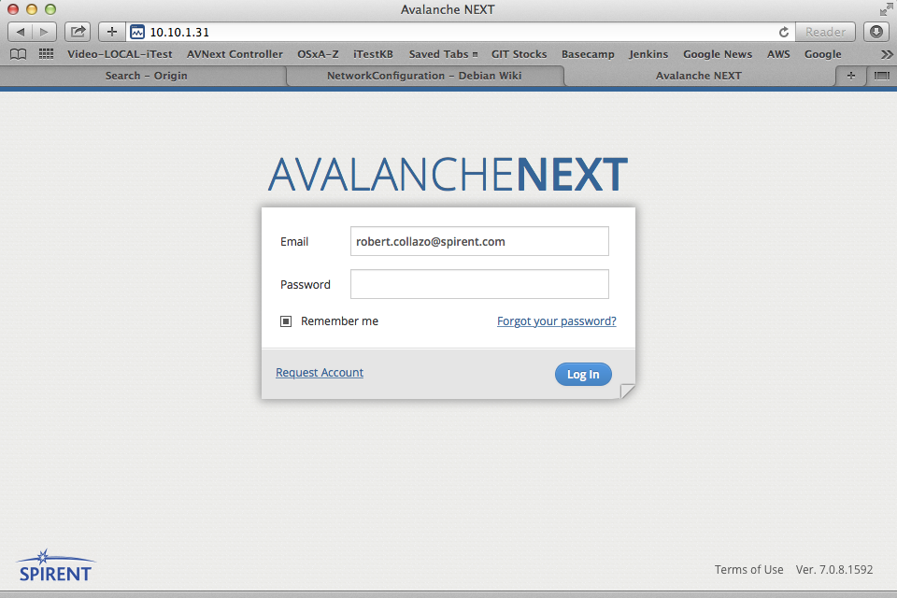
AVNext Controller VM
- hosted on Team ESXi
Login Screen

Slide 3
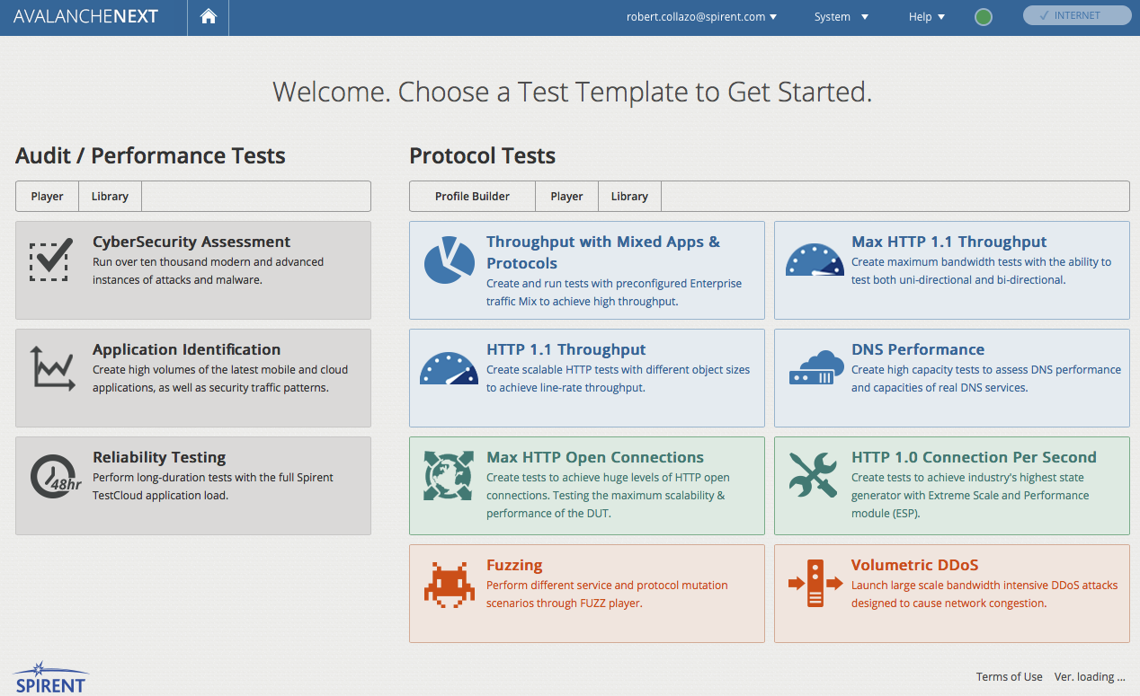
Welcome Screen

Slide 4
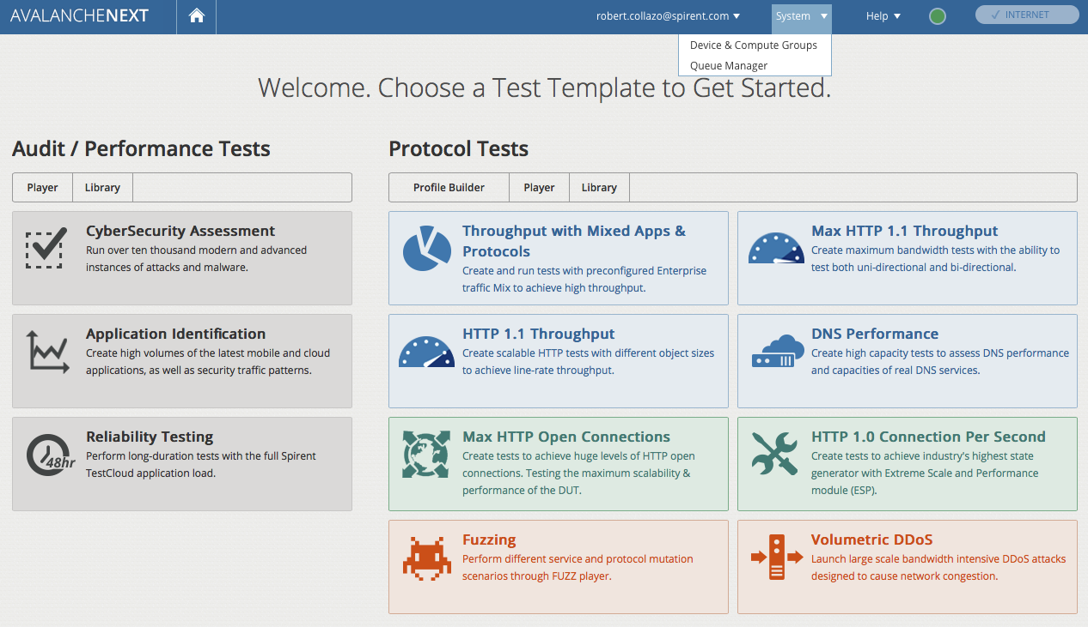
Pull Down
and Click

Slide 5
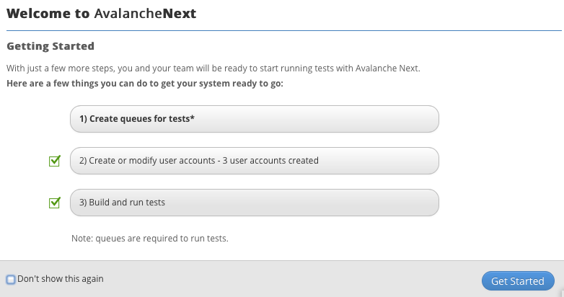
Click Button

Slide 6
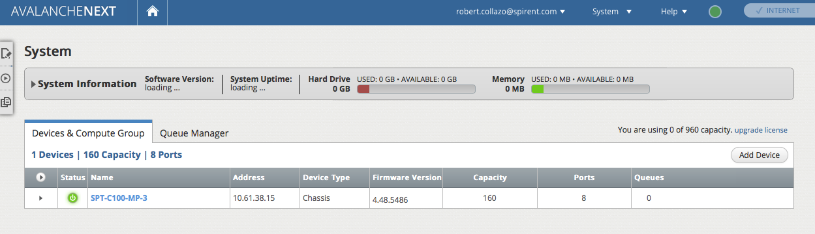
Pre-Defined Chassis
Optionally –
Add Additional
Chassis

Slide 7
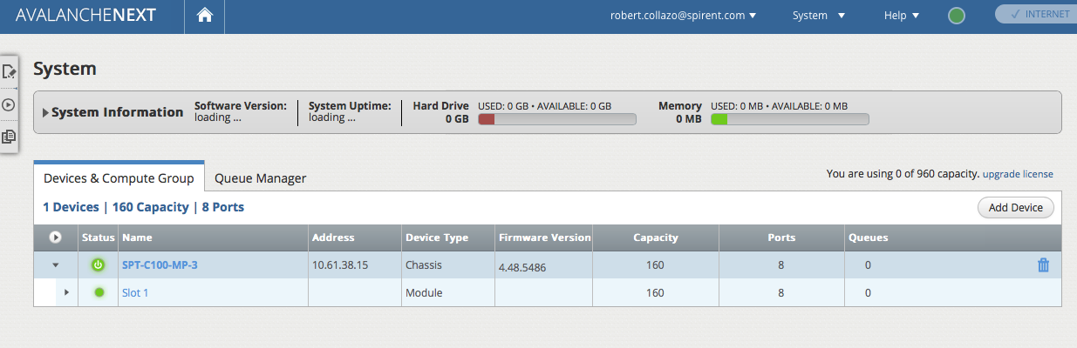
Click – to display Drop Down:
Chassis slots (Module Types)

Slide 8
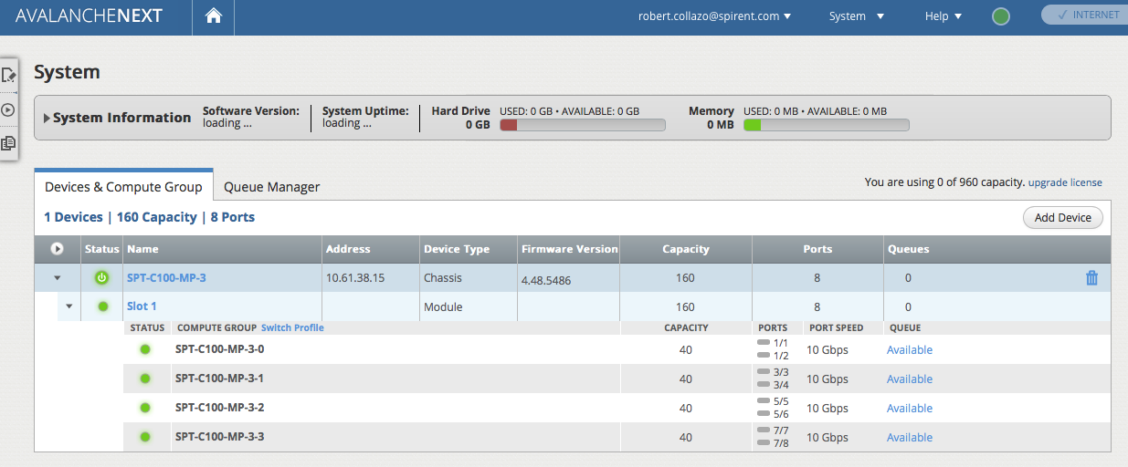
Click – to display Drop Down:
Compute (Port) Groups
Note:
Reservation
Status
Individual Physical Ports

Slide 9
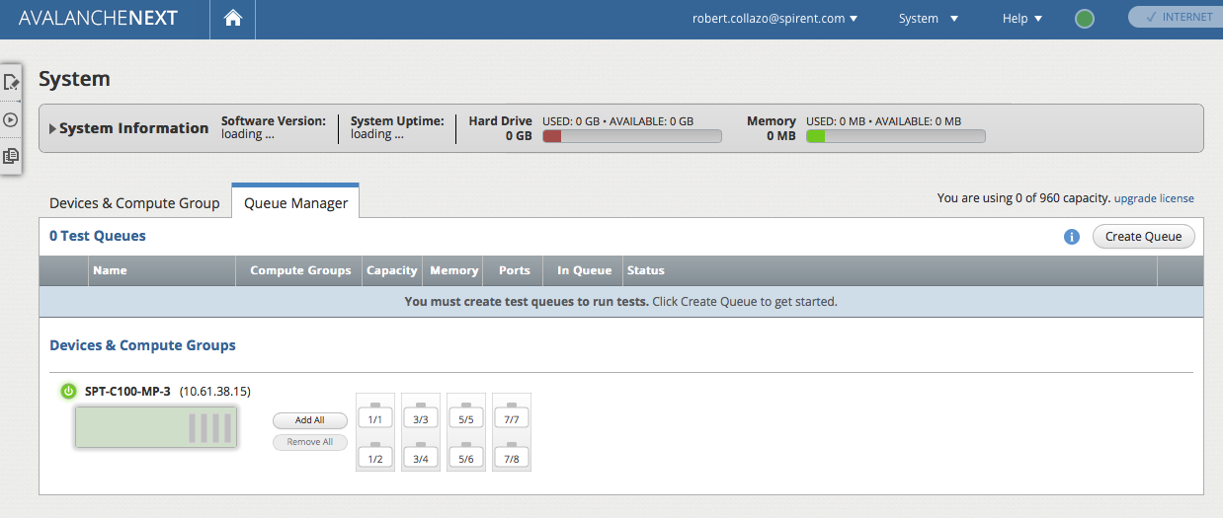
Click Tab

Slide 10
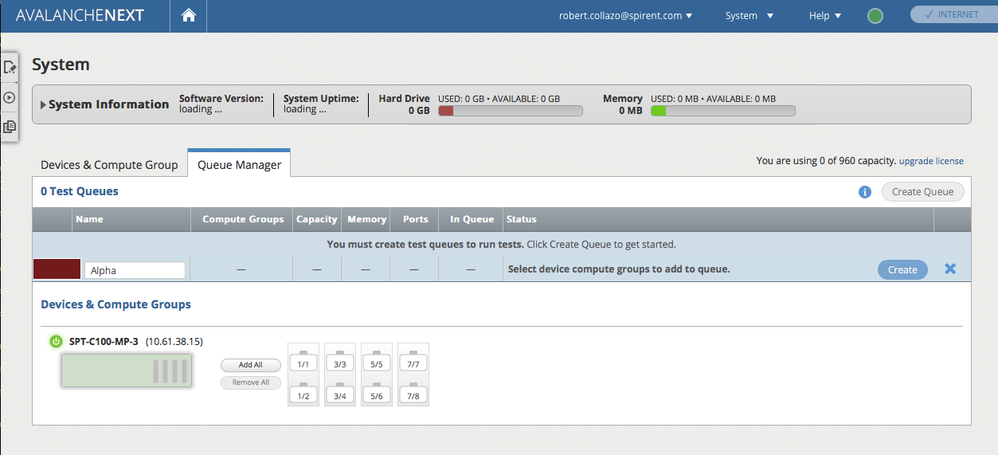
Click Button

Slide 11
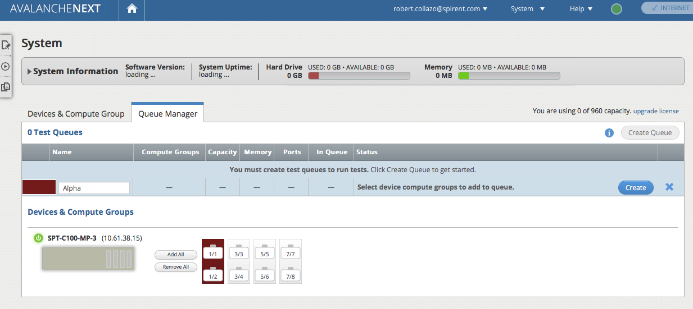
To Reserve:
Click middle

Slide 12
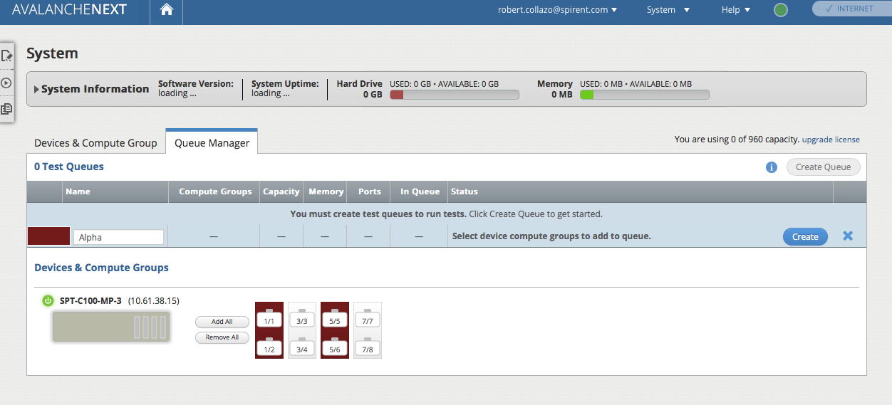
again, to Reserve:
Click middle
Click Button

Slide 13
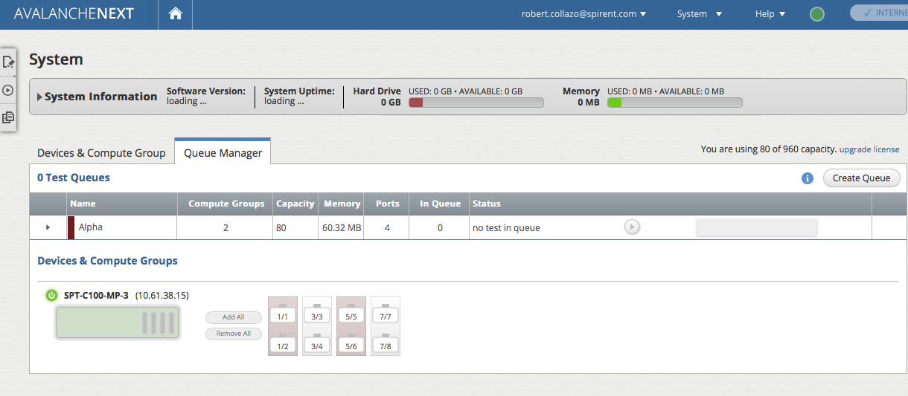
Queue is now defined,
- Test entry is TBD
For Next step,
Click “Player”
icon

Slide 14
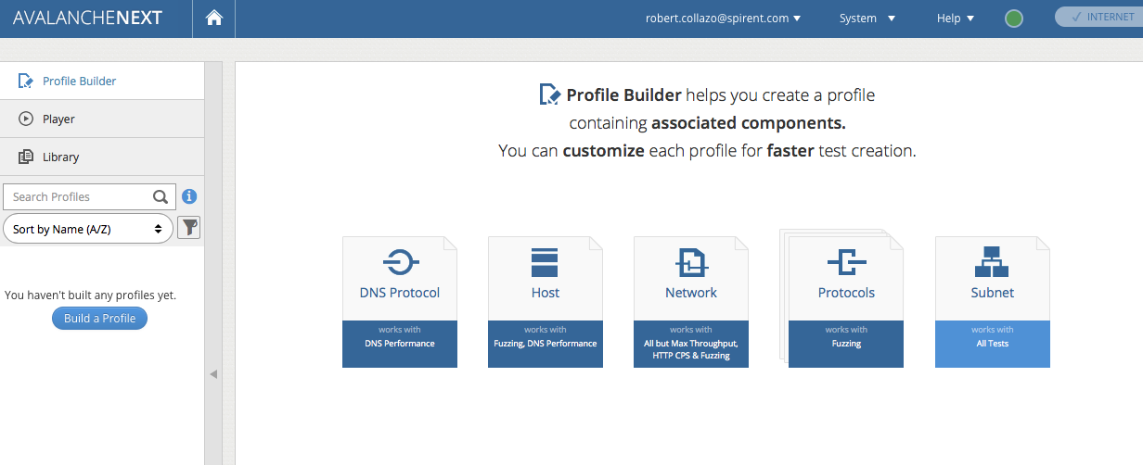
Click Icon

Slide 15
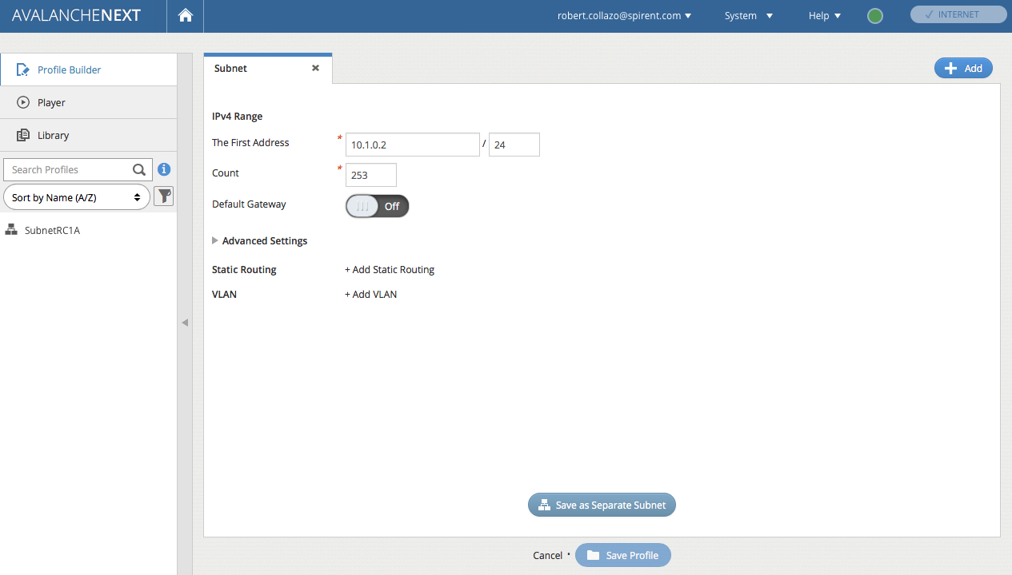
Accept defaults
Click Button

Slide 16
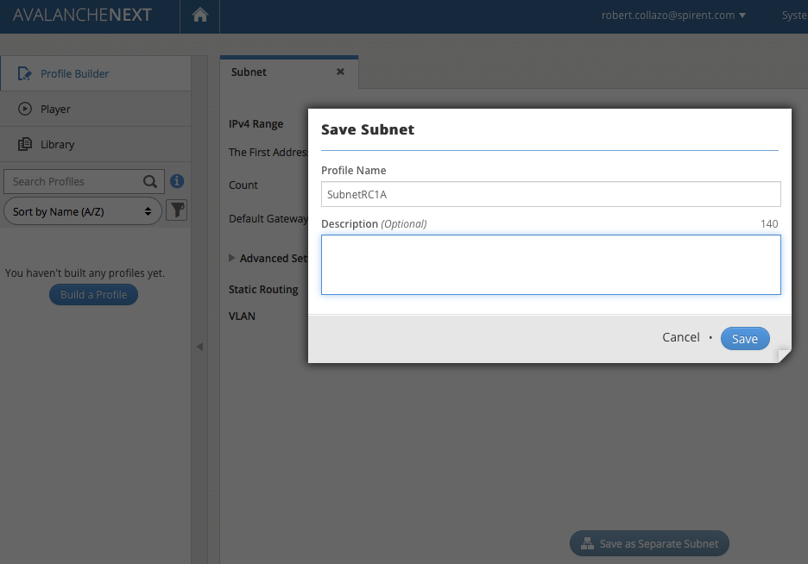
Suffix name with “RC1A”
For Client subnet addresses

Slide 17
Accept defaults. . .
Same subnet
Click Button

Slide 18
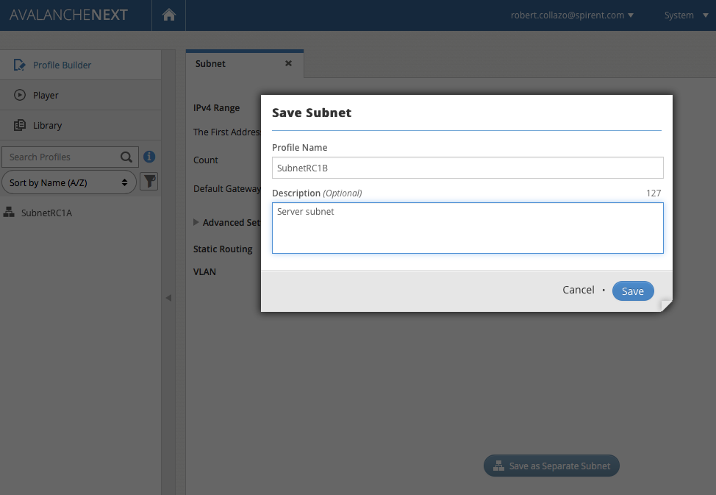
Suffix name with “RC1B”
For Server subnet addresses

Slide 19
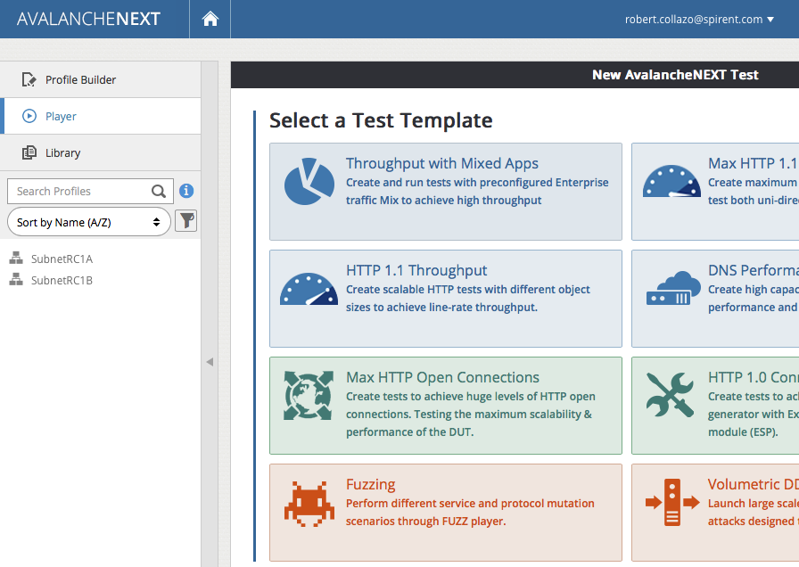
Note:
newly created
Profiles
Next step,
Select Throughput
Test

Slide 20
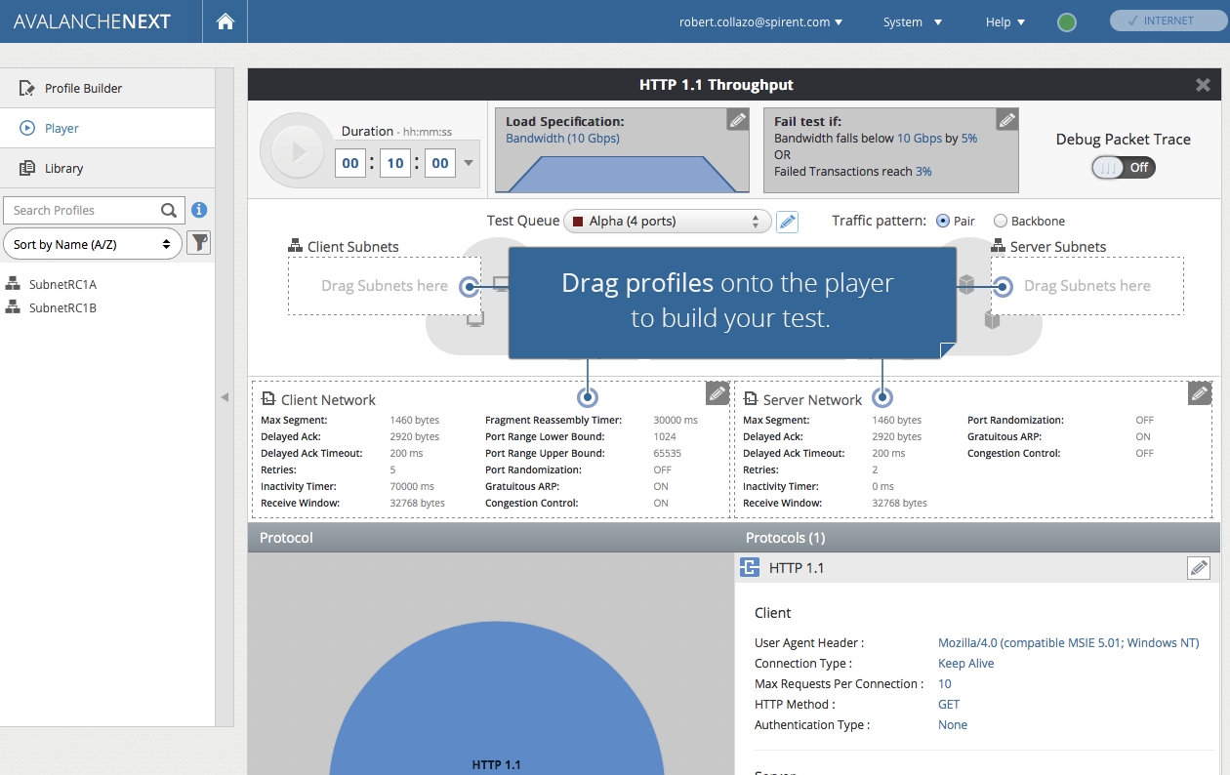
Note:

Slide 21
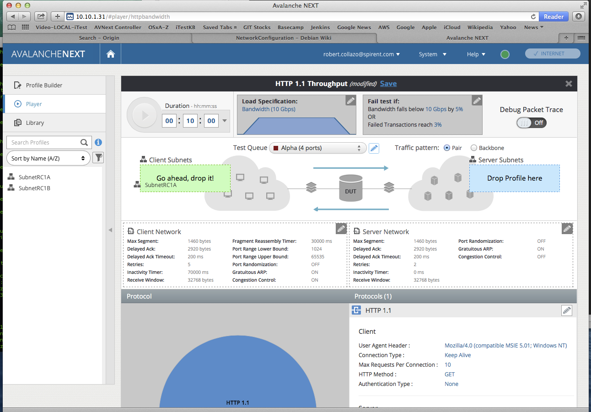
‘Dragging’
SubnetRC1A
On to Client

Slide 22
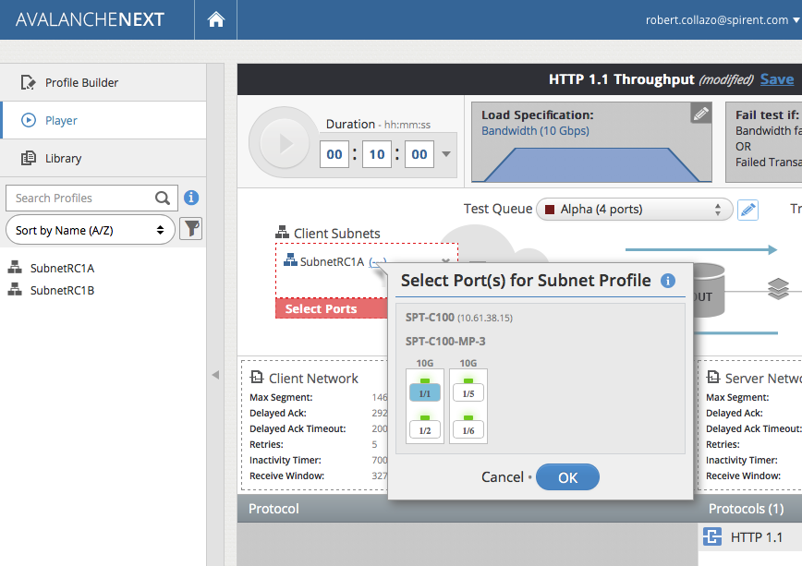
After‘Drop’,
Pop-Up displays
Client Port
Selection. . .
Click Port
icon

Slide 23
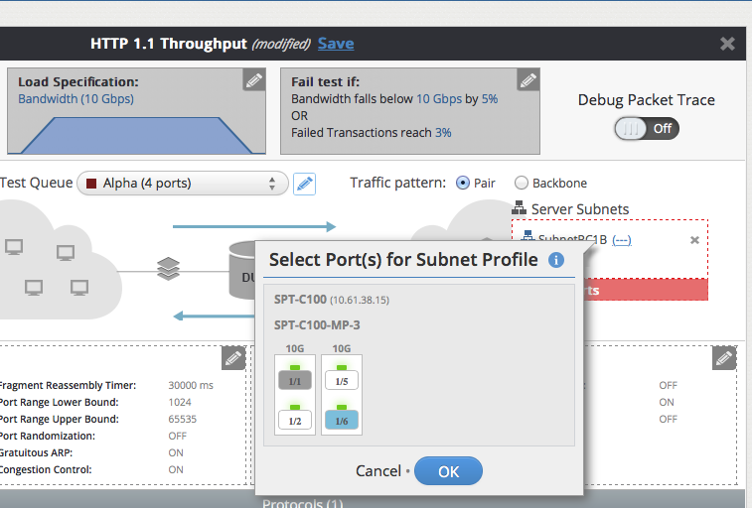
After Drag & Drop,
Pop-Up displays
Server Port
Selection. . .
Click Port
icon

Slide 24
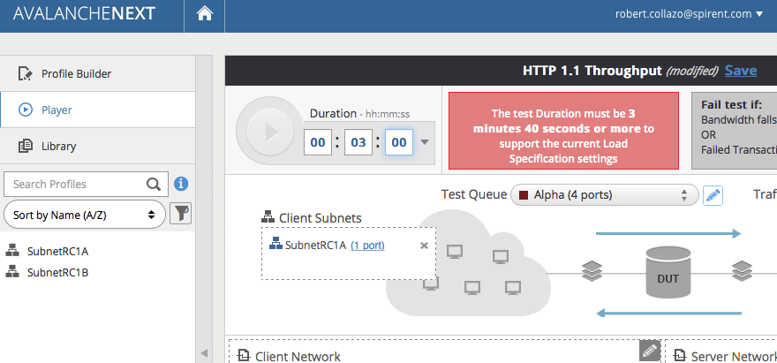
Adjusting Test Duration
Note Warning . . .

Slide 25
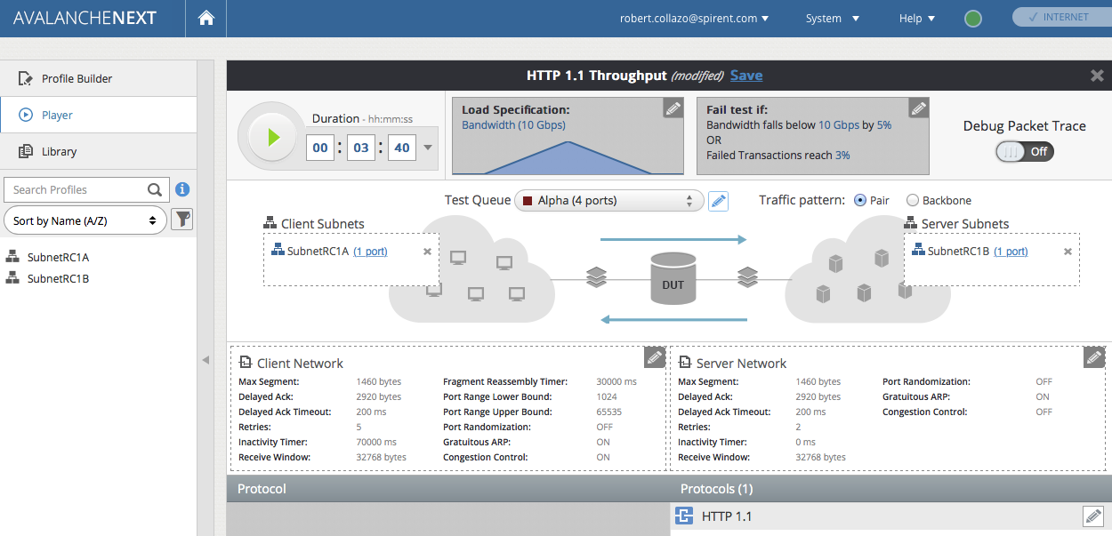
Click ‘Save’
Button

Slide 26
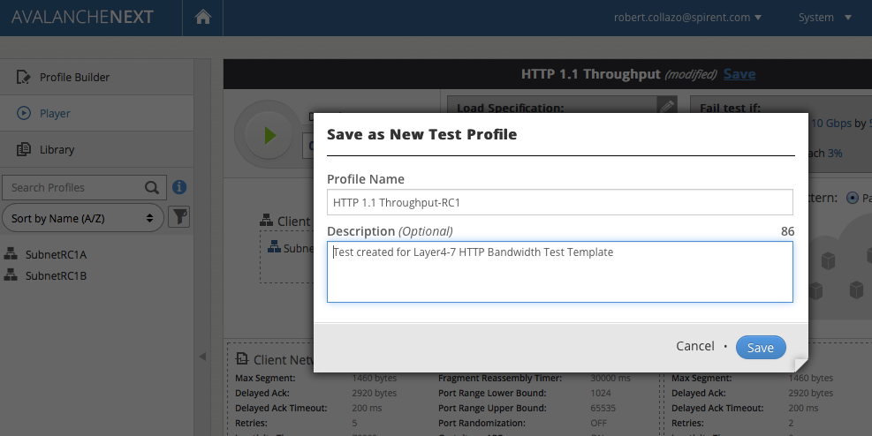

Slide 27
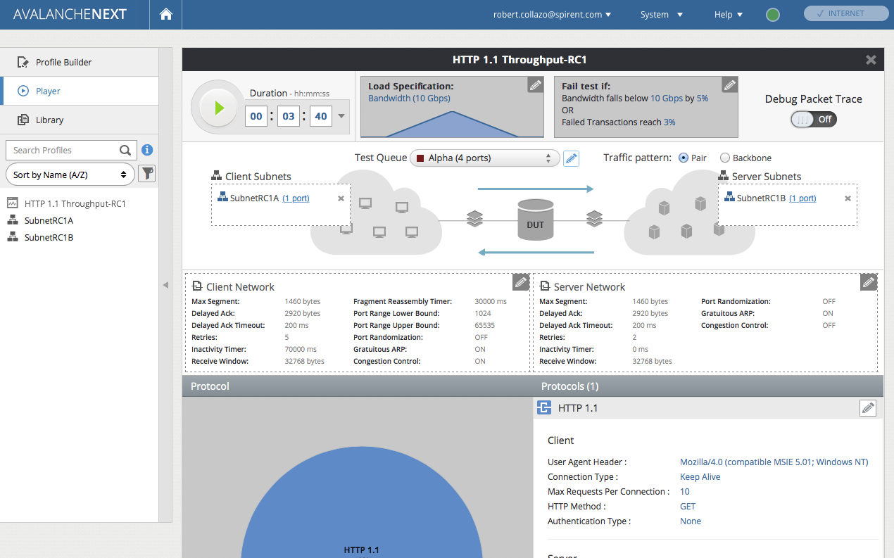
Start Test

Slide 28
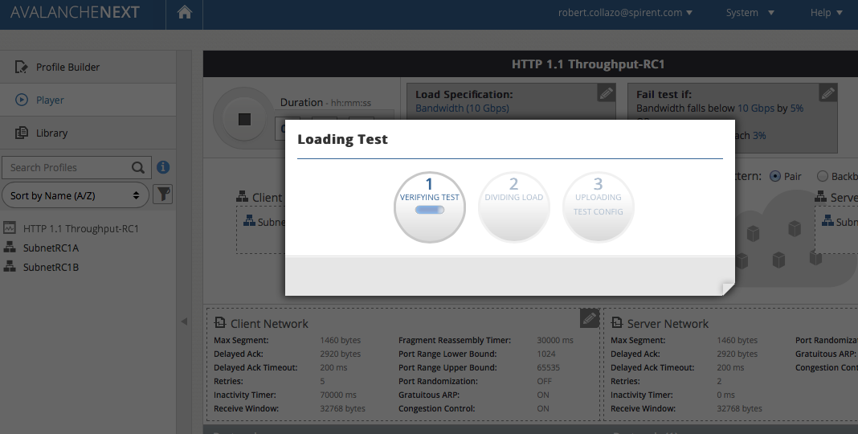

Slide 29
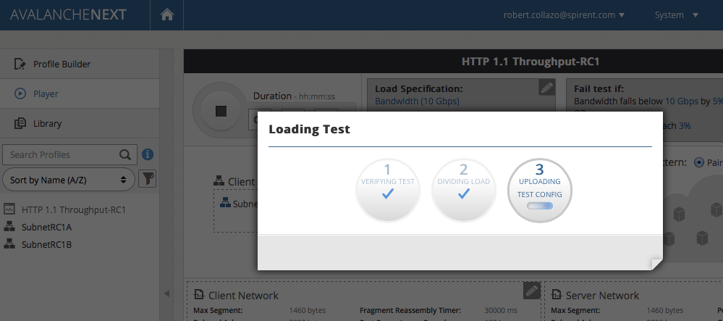

Slide 30
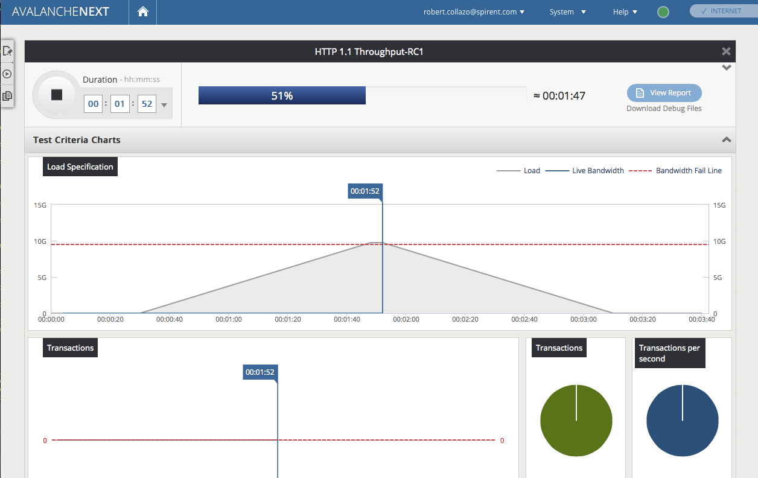
During this time frame, in separate Terminal
Window – force some disruptive traffic:
ping –s 4096 spirent.com

Slide 31
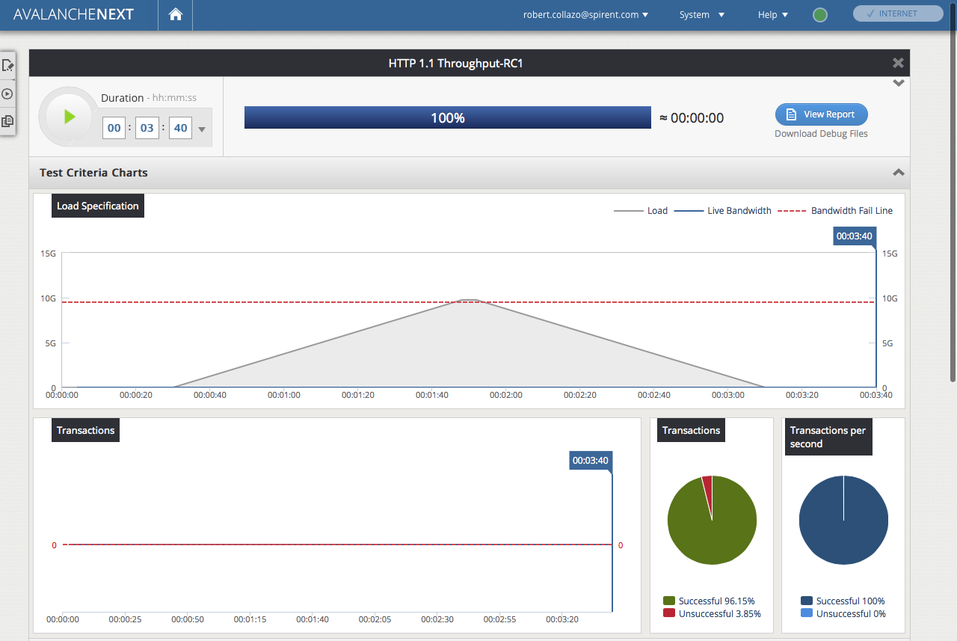
Rate is effected . . .

Slide 32
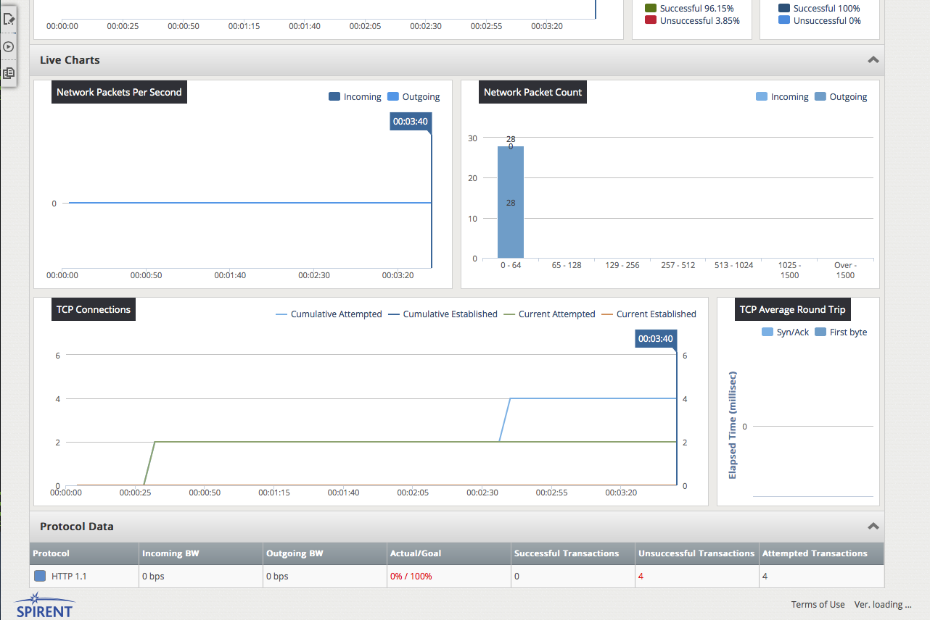
scroll to Bottom:
bottom half of Final Results displayed

Slide 33
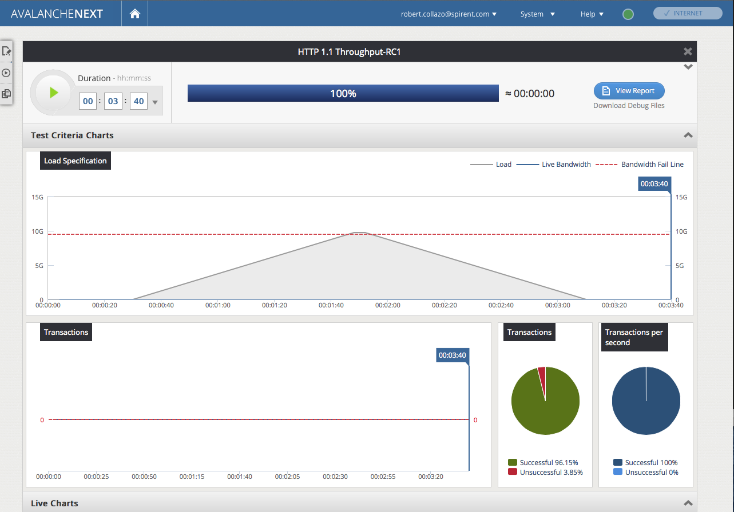
scroll back to Top:
top half of Final Results displayed
Lastly, click Report Button

Slide 34
